Slide 1
Adversarial Attacks in Physical World
KAICHEN YANG
University of Florida

Slide 2
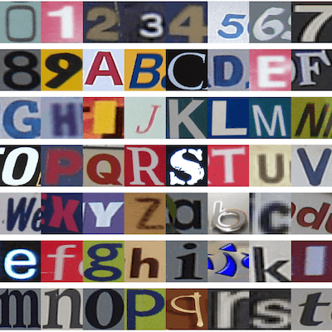

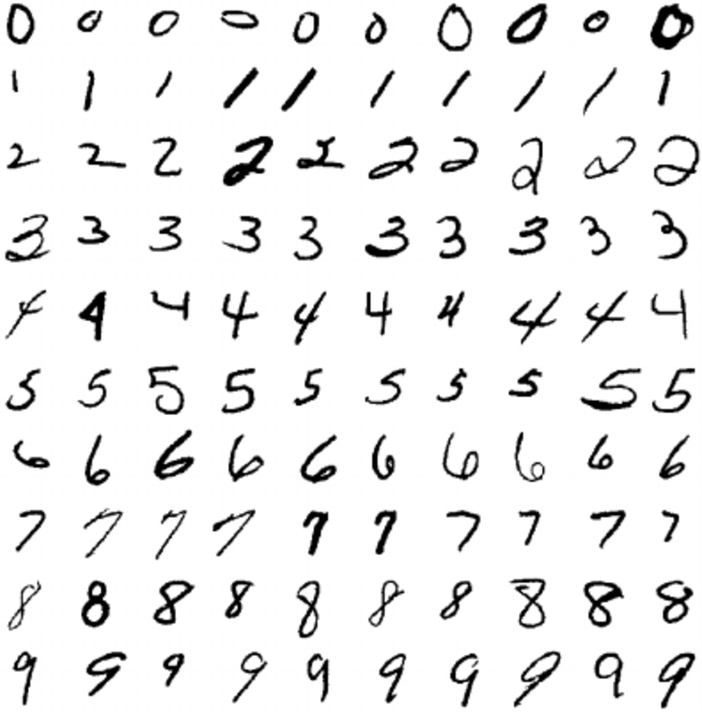
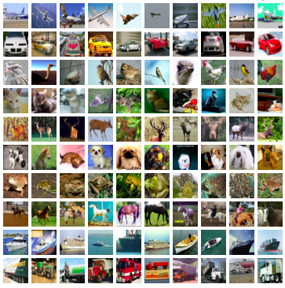
Background – Success of Machine Learning
“Perceptron”
“Multi-Layer Perceptron”
“Deep Convolutional Neural Network”
A variety of Intelligent Applications:

Slide 3
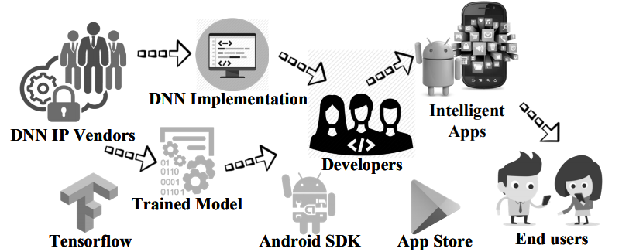
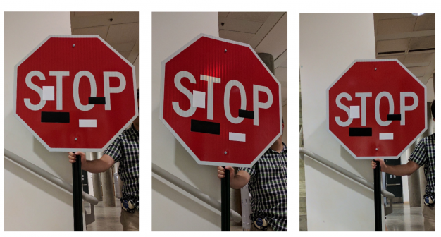
Motivation – Emerging DNN security
DNN model architecture is implemented by the untrusted 3rd part developers;
Fooling a normally trained DNN model (misclassify)
Small perturbations of the input or generative modeling (Adversarial Attacks)
Contaminated parameters (Poisoning Attacks)
stop sign is reliably misclassified as a Speed Limit 45 sign.
Machine Learning Model Supply Chain

Slide 4
Adversarial examples: an example
Papernot et al. designed an efficient saliency adversarial map to select the feature/pixel to be crafted, called Jacobian-based Saliency Map Attack (JSMA) .

Slide 5
Adversarial examples: state of art
Methods for generating adversarial examples:
L-BFGS attack
Fast Gradient Sign Method (FGSM)
Jacobian-based Saliency Mao Attack (JSMA)
C&W’s Attack
Natural GAN
…

Slide 6
Adversarial examples: state of art
Defense for adversarial examples:
Network Distillation
Adversarial Training
Adversarial Detector
Dimensionality Reduction
Distributional Detection
…

Slide 7
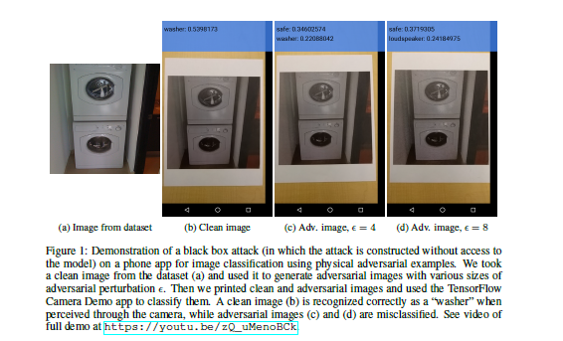
Adversarial examples: photos
Kurakin A, Goodfellow I, Bengio S. Adversarial examples in the physical world[J]. arXiv preprint arXiv:1607.02533, 2016.

Slide 8
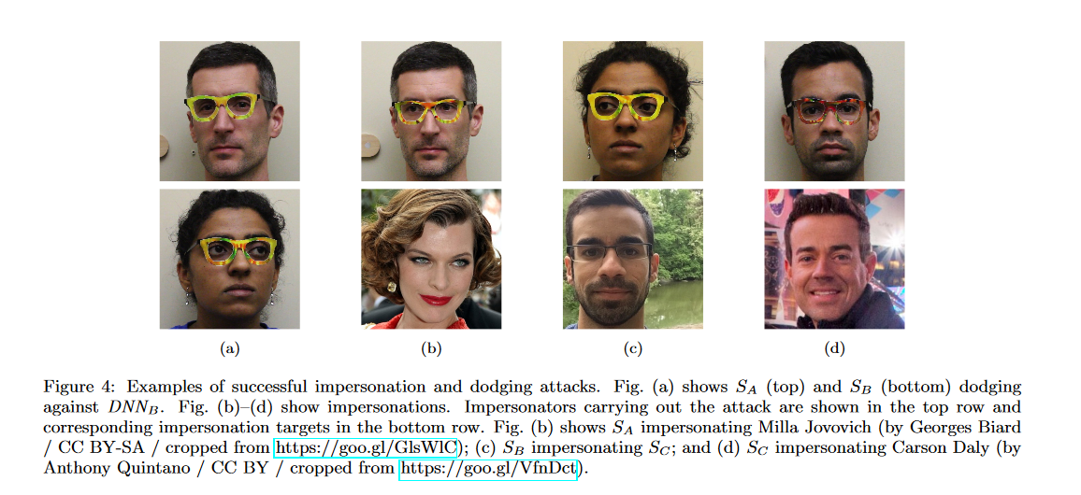
Adversarial examples: glasses
Sharif M, Bhagavatula S, Bauer L, et al. Accessorize to a crime: Real and stealthy attacks on state-of-the-art face recognition[C]//Proceedings of the 2016 ACM SIGSAC Conference on Computer and Communications Security. ACM, 2016: 1528-1540.

Slide 9
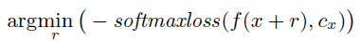
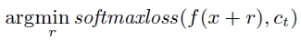
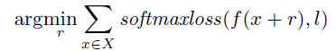
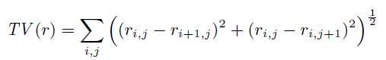
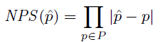
Adversarial examples: glasses
Effects:
Dodging:
Impersonation:
Challenges:
Robustness:
Smoothness:
Printability:

Slide 10
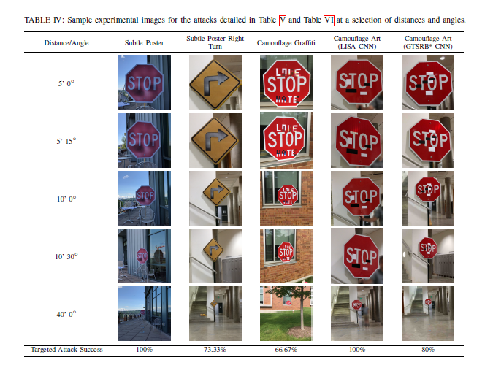
Adversarial examples: road sign
Evtimov I, Eykholt K, Fernandes E, et al. Robust physical-world attacks on deep learning models[J]. arXiv preprint arXiv:1707.08945, 2017, 1.

Slide 11
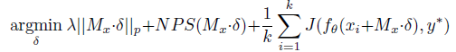
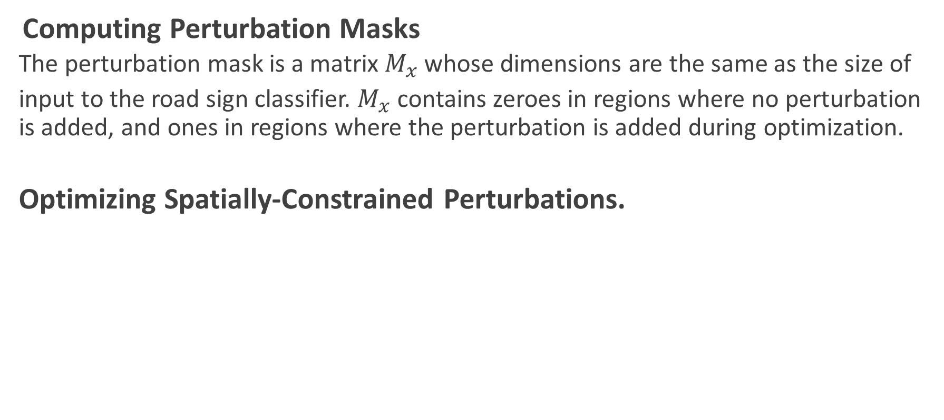
Adversarial examples: road sign
Computing Perturbation Masks
The perturbation mask is a matrix $M_{x}$ whose dimensions are the same as the size of
input to the road sign classifier. $M_{x}$ contains zeroes in regions where no perturbation is added, and ones in regions where the perturbation is added during optimization.
Optimizing Spatially-Constrained Perturbations.
Evtimov I, Eykholt K, Fernandes E, et al. Robust physical-world attacks on deep learning models[J]. arXiv preprint arXiv:1707.08945, 2017, 1.

Slide 12
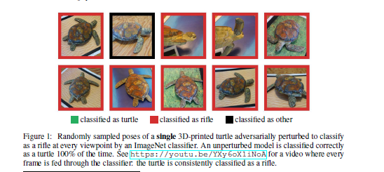
Adversarial examples: 3D object
Athalye A, Sutskever I. Synthesizing robust adversarial examples[J]. arXiv preprint arXiv:1707.07397, 2017.
Notes:
Meltdown and Spectre two attacks abuse out-of-order execution on speculatively executed instruction sequences to leak secret data or control code execution.
In particular, they abuse transient data stored in the cache hierarchy, or branch history buffer, subsequent to the microarchitecture rolling back due to an exception.
Both attacks work across address spaces.
Our covert channel abuses the memory ordering buffer and the microarchitecture used to maintain memory consistency internal to the pipeline → no cache effects.
They can be considered close cousins.

Slide 13

Adversarial Attacks in Physical World
Athalye A, Sutskever I. Synthesizing robust adversarial examples[J]. arXiv preprint arXiv:1707.07397, 2017.
Notes:
Meltdown and Spectre two attacks abuse out-of-order execution on speculatively executed instruction sequences to leak secret data or control code execution.
In particular, they abuse transient data stored in the cache hierarchy, or branch history buffer, subsequent to the microarchitecture rolling back due to an exception.
Both attacks work across address spaces.
Our covert channel abuses the memory ordering buffer and the microarchitecture used to maintain memory consistency internal to the pipeline → no cache effects.
They can be considered close cousins.

Slide 14
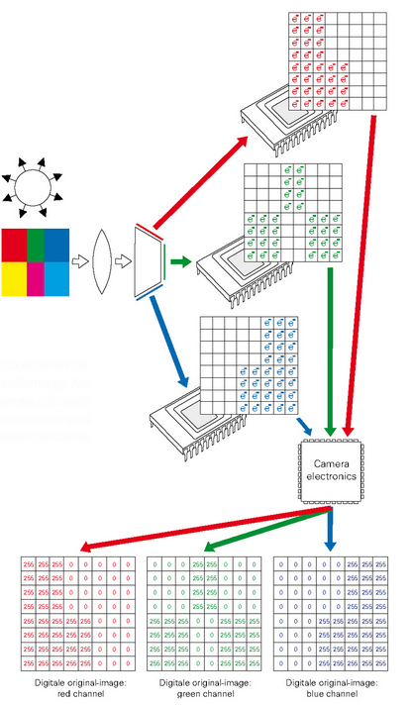
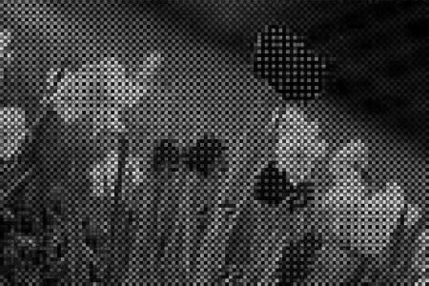
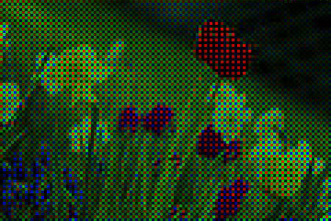

Adversarial examples: light
Post processing:
White balance correction
gamma correction
applied style curve,
noise reduction sharpening
……

Slide 15
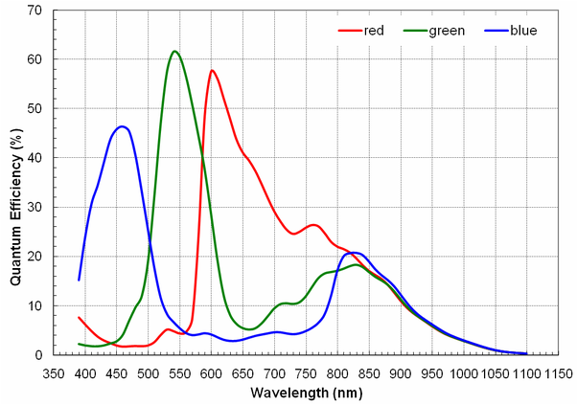
Adversarial examples: light

Slide 16
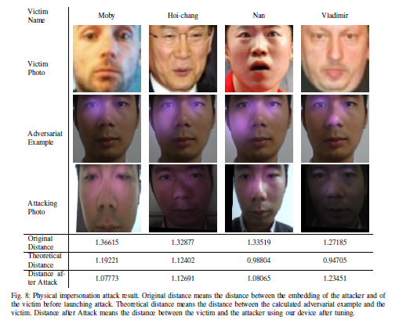
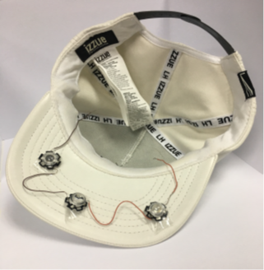
Adversarial examples: light
Zhou Z, Tang D, Wang X, et al. Invisible Mask: Practical Attacks on Face Recognition with Infrared[J]. arXiv preprint arXiv:1803.04683, 2018.

Slide 17

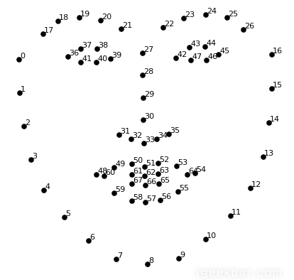
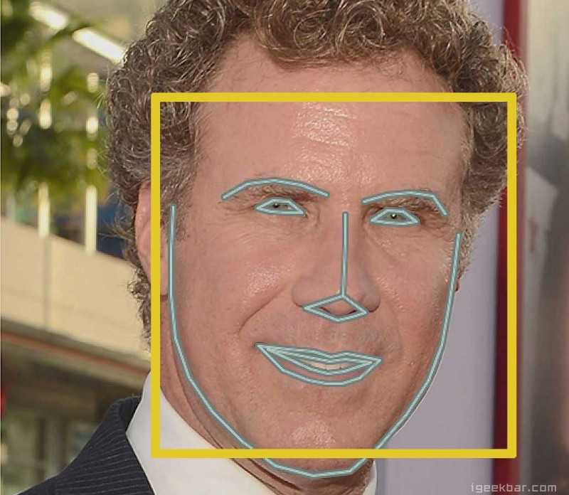
Adversarial examples: light
Dodging:
In face recognition system each image is firstly preprocessed to extract its face portion only. Images will be sent to a land marking model that identifies a set of land mark points for each face on the image.
With enough amount of infrared on face, the preprocessing step will fail, i.e., causing the face landmarking model to fail to output a set of valid land mark points

Slide 18
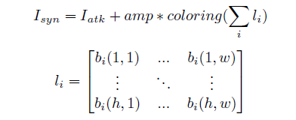
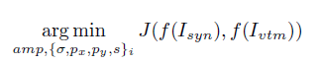
Adversarial examples: light
Impersonation:
The infrared light spot is modeled according to its position on face, brightness and size. The brightness of a pixel is modeled as
The synthesized image is modeled as

Slide 19
Conclusion
How to apply adversarial attacks in physical world is still an open problem
How to model the generation of images from the physical world is critical.
Notes:
Meltdown and Spectre two attacks abuse out-of-order execution on speculatively executed instruction sequences to leak secret data or control code execution.
In particular, they abuse transient data stored in the cache hierarchy, or branch history buffer, subsequent to the microarchitecture rolling back due to an exception.
Both attacks work across address spaces.
Our covert channel abuses the memory ordering buffer and the microarchitecture used to maintain memory consistency internal to the pipeline → no cache effects.
They can be considered close cousins.

Slide 20
Thank you

